Slide 1
Final Exam Review
Copyright 2021-2022 Warren Mansur. Permission granted for any use of Boston University.

Slide 2
Final Exam Basics
You have 3 hours to complete the exam, which is proctored online with Examity.
You can bring 2 physical pieces of paper with notes. No other materials are allowed.
The exam is cumulative and focuses on the learning objectives and significant subject areas from the first 5 weeks.
Week 6 material and readings will not be on the final exam.

Slide 3
Question Layout
The final exam starts with 3 essay questions about your term project, and follows with 2 essay questions with scenarios that require understanding of significant course subjects.
Each question is worth 20 points.
You may opt to complete your project questions or the scenario questions first depending upon what works best for you.

Slide 4
Project Questions
You will be asked to extend upon your existing project’s structure and implementation, but will not be grilled on details of the existing implementation.
The questions will cover the structural database rules, the relationships and constraints, attributes, SQL, and queries.

Slide 5
Project Questions
In order to extend upon the project, it is essential that you keep key project information on your 2 pages of notes, including your DBMS physical ERD, and other items you feel relevant (perhaps use cases, queries, etc …).
External software will not be needed. The questions are essay based.

Slide 6
Scenario Questions
These questions present a scenario, and ask you to address several aspects (denoted with a, b, etc …)
Answering these successfully requires comprehension and applied knowledge of significant course subject areas.
These questions cover different concepts than the project questions.

Slide 7
Question Evaluation
Your facilitator will evaluate each question with a rubric specific to the question.
Your facilitator will grade each question with the same rigor as the iterations, and they will leave you a one or two sentence summary of their review that you will see when the final is released.

Slide 8
Study Strategies
Know your project well.
Review the main concepts from textbook, online lectures and assignments, and labs. The final exam is designed to cover the most significant topics from each week.
For the “biggest point gain”, carefully study subject areas where you earned a lower grade. Focus on areas needing most improvement.
The questions are designed to assess your comprehension of the material or the ability to apply the material to specific problems. This is in contrast to knowledge recall questions which ask you only to recall a piece of information.
The way we as human beings are wired, we learn better incrementally rather than in long blocks. The earlier you can begin studying, the more material you are likely to retain and understand. Also, breaking study periods into 15-20 minutes blocks with breaks in-between can help you retain information better.

Slide 9
Whirlwind Significant Topic Overview

Slide 10
What is a Database?
A database is an application designed to provide long-term storage of data.

Slide 11
Who Uses Databases?
Virtually every organization (and most people) in the world uses a database directly or indirectly.
For-profit companies, not-for-profits, governments, clubs, and individuals use databases.

Slide 12
Why Use Databases?
File System
Database
Structural Independence
Efficient Access
Granular Security
Simplicity
Language/API Access
Notes:
Databases provide four critical features beyond data storage – data security, and efficient access, structural independence, and consistent accessibility.
Databases ensure that only authorized people can make use of the data, typically with extensive and customizable data security configurations.
Databases ensure that just the right data items can be retrieved quickly (typically in less than a second) from amongst a potentially vast amount of storage.
Databases provide a level of abstraction so that applications are immune to server and file structure changes.
Databases provide a full-featured language and/or API so that applications can retrieve data consistently.
The only significant advantage of using file systems for storing data is that is relatively much simpler.

Slide 13
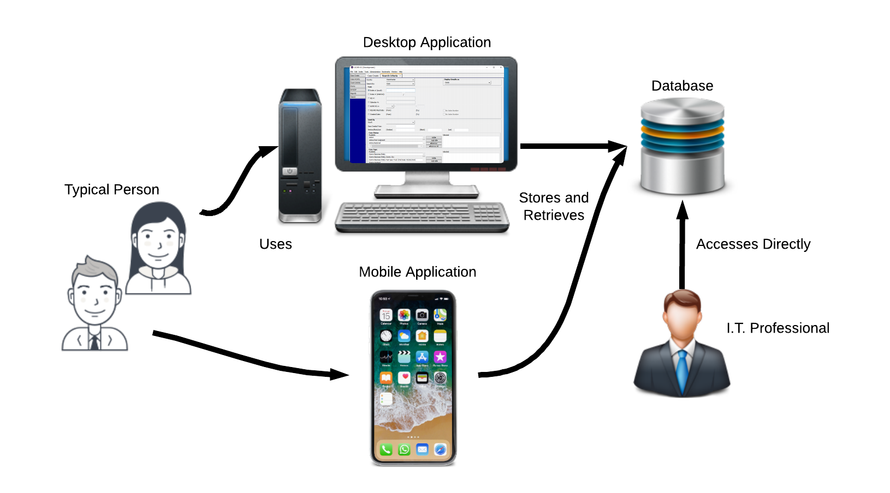
Typical Database Usage
Notes:
Almost all database access is indirect; people use an application which uses a database.
Websites such as Amazon.com
Mobile applications
Business applications
Applications, typically object-oriented, focus on managing transient types and on presenting interfaces to the end user.
The database’s role for the application is to store and provide access to durable types.
I.T. professionals such as database administrators, database developers, and data analysts, access the database directly.

Slide 14
Flat Data
There is no formal way to reference a data item.
Example: There is no formal way to reference a customer’s name within a purchase record.
Flat data is repeated for every occurrence.
Example: A customer’s name is repeated for every purchase.
Result: Subject to data anomalies.

Slide 15
Data Anomalies
Deletion Anomaly: When deletion of one set of data items mistakenly results in the deletion of another set of data.
Example: When only one customer purchased a product, and that purchase is deleted, the product is also deleted.
Update Anomaly: When some but not all occurrences are updated.
Example: A customer’s phone number is changed in 3 out of 5 occurrences.
Insertion Anomaly: When what is supposed to be the same data is inserted differently than its counterpart.
Example: A customer’s phone number is listed in another record, and a different phone number is inserted into a new record for the same customer.

Slide 16
Relational Data
There is a formal way to reference a data item.
Example: A purchase record references a customer’s name.
When properly normalized, data is not repeated; rather, it is referenced.
Result: Elimination of or mitigation for data anomalies.

Slide 17
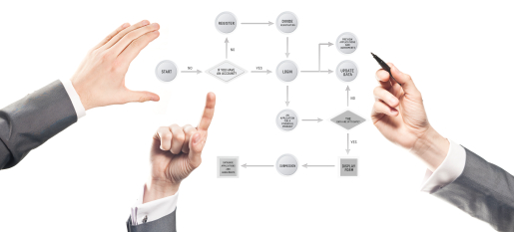
Data Modeling
Notes:
A data model, therefore, is a representation or description of data that describes the data.
Data and databases are modeled before they are implemented.
The model determines how the data is stored and how the database is used.
Typically data models define the structure of the data and identify relationships in the data.
Data models provide a mechanism whereby many individuals to discuss, analyze, and change the implementation in a low cost manner.

Slide 18
The Relational Model
In 1970, E.F. Codd proposed a data model he termed the “relational model”.
An overwhelming majority of databases in use today are relational databases.
Structured Query Language (SQL) is the universal language for relational databases.

Slide 19
Database Popularity
Notes:
Relational databases are by far the most popular and used kind of database (Solid IT).
NoSQL and search databases are the most significant alternative.
Many texts treat “relational database” and “database” as synonymous terms.
Even the definition of alternative databases as “NoSQL” is a testament to the popularity of relational databases.
Relational databases are considered the foundational technology even if NoSQL databases are learned.
Works Cited
Solid IT (September 2018). DB-Engines Ranking. Retrieved September 4, 2018, from https://db-engines.com/en/ranking

Slide 20
Relational Model Components
Relation: Consists of rows and columns, where each row/column intersection has at most one value.
Column: A named aspect of a relation that has a set of legal values.
Row: One group of values for every column in a relation.
Relationship: When the same data value is duplicated in two different rows of the same or different relation, those rows are related.

Slide 21
ERD Components
Entity | A type; a blueprint which defines the structure for all of its instances.
Entity Instance | An occurrence; a realization of the blueprint defined by the entity.
Attribute | Describes an entity and have a datatype. May only contain a single value in the relational model.
Relationship | A relationship describes an association among entities

Slide 22
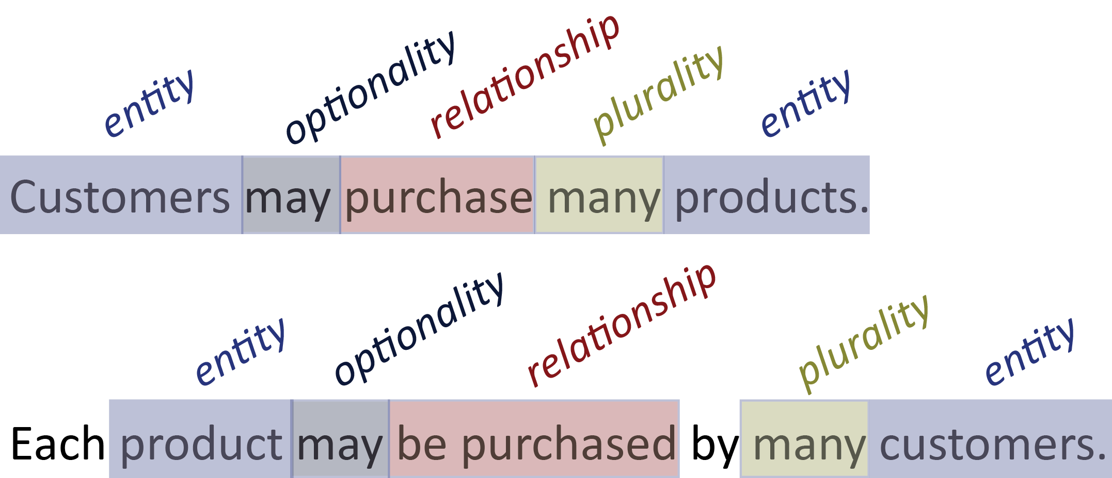
Structural Database Rules
Structural database rules describe entities, their relationship, and their relationship’s connectivities.
For example:

Slide 23
Types of ERDs
Model | Depends upon | Included
Conceptual | The problem domain only | Entities, relationships (including many to many), optionally attributes
Logical | The database model, which is commonly SQL relational, in addition to the problem domain | Entities, all attributes, relationships, bridge entities, and primary and foreign keys
DBMS Physical | The specific DBMS product in addition to the database model and problem domain | DBMS specific data types, entities, attributes, relationships, bridge entities, collection entities, primary and foreign keys, and general constraint implementation

Slide 24
Types of Relationships
An associative relationship:
describes an association among entities.
is the most lenient kind of relationship.
has participation and plurality constraints.
is informally known as an “has a” relationship.
A specialization-generalization relationship:
indicates specialized forms of an abstraction.
has completeness and disjointness constraints.
is informally known as a “is a” relationship.

Slide 25
Associative Participation Constraint
Optional – Each instance of an entity is not required to participate in the relationship.
Example: Though some people own cars, not all people own cars.
Mandatory – Each instance of an entity is required to participate in the relationship.
Example: All dependents must be linked to an employee.

Slide 26
Associative Plurality Constraint
Singular – Each instance of an entity may be related to at most one instance.
Example: Every purchase is made by a single customer.
Plural – Each instance of an entity may be related to many instances.
Example: Customers may purchase many products..

Slide 27
Specialization-Generalization Completeness
Partially Complete - There may be an instance of the supertype without any corresponding instance of the subtype. The list of subtypes is not exhaustive.
Example: Though a car may be a Honda, a Toyota, or any of the other many kinds available, we only have a Honda and Toyota subtype in the model.
Totally Complete – There must be an instance of a subtype for every instance of the supertype. The list of subtypes is exhaustive.
Example: A material must be a solid, liquid, gas, or plasma, and we have all four subtypes in our model.

Slide 28
Specialization-Generalization Disjointness
Disjoint – There may be at most one subtype instance associated with a single supertype instance.
Example: A product may be a pencil, or a book, but cannot be both, and Pencil and Book are subtypes of Product in our model.
Overlapping – There may be multiple subtype instances associated with a single supertype instance.
Example: A person may be both a mechanic and a pilot, and Mechanic and Pilot are subtypes of Person in our model.

Slide 29
Extended ERD Example – Crow’s Foot

Slide 30
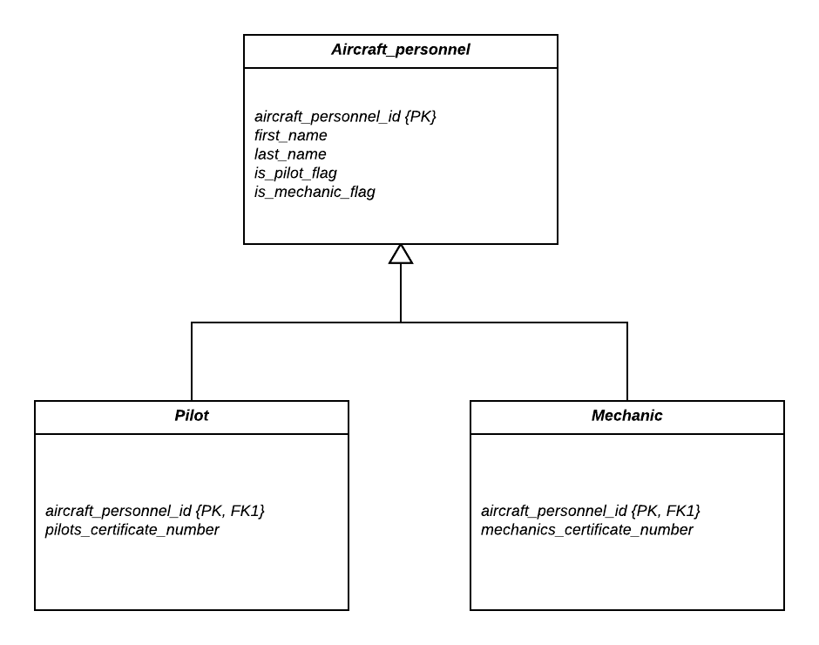
Extended ERD Example - UML

Slide 31


EERD Constraint Representation
 | Partial | Total
Crow’s Foot Extensions
UML | OPTIONAL | MANDATORY
 | Disjoint | Overlapping
Crow’s Foot Extensions | d | O
UML | OR | AND

Slide 32
Normalization
Normalization is the universally accepted method of reducing data redundancy.
Normalization works by identifying dependencies between database columns and eliminating unwanted dependencies.
When a table is normalized, it may result in additional tables.
It is normal practice to normalize tables for operational databases.

Slide 33
Normal Forms
Form | Requirement
1NF | No repeating groups
2NF | 1NF and no partial dependencies
3NF | 2NF and no transitive dependencies
BCNF | All determinants are a candidate key

Slide 34
Transaction Terms
Term | Definition
Connection | A communication pathway between a client process and a database instance.
Session | An independent association between a connection and a particular instance of user authentication, created in the DBMS instance’s memory.
Transaction | An action, or series of actions, carried out by user or application, which reads or updates contents of database; a logical unit of work in the database, associated with a session.

Slide 35
ACIDS Transaction Properties
Atomicity is the “All or nothing” property. All changes in the transaction are applied, or none of them are applied. There is no middle ground.
Consistency Transactions must transform the database from one consistent state to another.
Isolation Changes made by incomplete (uncommitted) transactions should not be visible to other transactions.
Durability The effects of a committed transaction are permanent and must not be lost because of later failure of the platform or DBMS.
Serializability To each transaction the database behaves as if this were the only transaction.

Slide 36
Unmanaged Concurrency Problems
Lost Update
Results from one transaction are overwritten by a simultaneously executing transaction.
Uncommitted Dependency
Occurs when a transaction writes incorrect values to the DBMS as a result of reading updated values from simultaneously executing, uncommitted transactions.
One possible result of a “dirty read”.
Inconsistent Analysis
Occurs when a transaction reads several related values from the database, but some of those values have been updated by simultaneously executing transactions.
Another possible result of a “dirty read”.

Slide 37
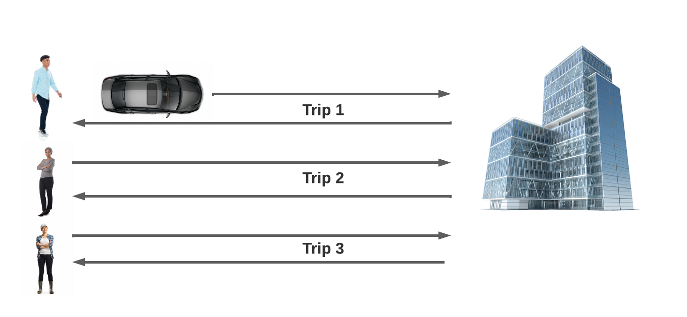
Serial Execution Analogy

Slide 38
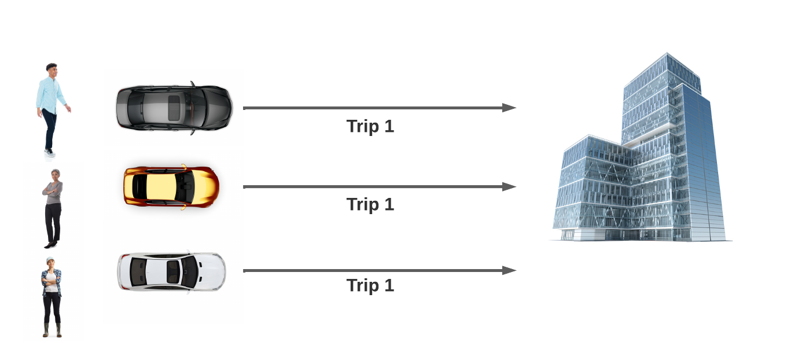
Parallel Execution Analogy

Slide 39
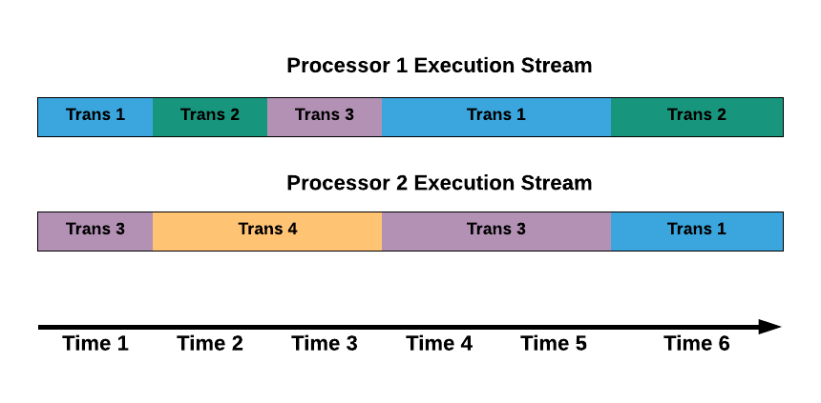
Transaction Scheduling Visual

Slide 40
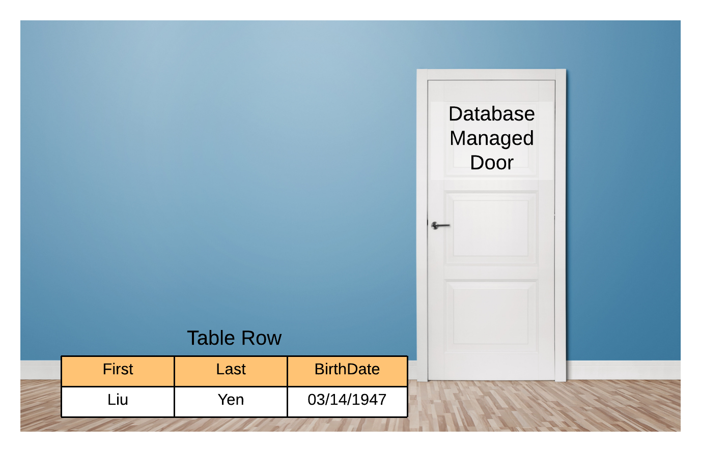
Locking Analogy

Slide 41

Analogy – Shared Lock

Slide 42

Analogy – Exclusive Lock

Slide 43

Deadlock Analogy
Notes:
Interleaving transactions which lock the same data items in a different order may result in a deadlock.
An impasse that may result when two (or more) transactions are each waiting for locks held by the other(s) to be released.
When a DBMS detects a deadlock, an error is given on the deadlocking statement, or a victim transaction is aborted to allow the other transactions to continue.

Slide 44
Locking Terms
Term | Definition
Shared Lock | An indicator on a data item that indicates that other transactions may acquire shared locks on the same data item, but not exclusive locks.
Exclusive Lock | An indicator on a data item that indicates that no other transaction may have any kind of lock on the same data item.
Wait | Occurs when one transaction has an exclusive lock on a data item, and another transaction wants any kind of lock on that data item, or when one or more transactions have a shared lock on a data item, and a transaction wants and exclusive lock.
Deadlock | An impasse that may result when two (or more) transactions are each waiting for locks held by the other(s) to be released
Multiversioning | A history of values for every row are recorded; reads pull the correct value from each row, regardless of the number of updates.

Slide 45
BASIC SQL SELECT
SELECT tbl.columnA, other_tbl.columnB FROM tbl JOIN other_tbl ON tbl.clm = other_tbl.clm
WHERE tbl.columnC > 5

Slide 46
BASIC AGGREGATION
SELECT tbl.columnA, MAX(other_tbl.columnB) FROM tbl JOIN other_tbl ON tbl.clm = other_tbl.clm
WHERE tbl.columnC > 5
GROUP BY tbl.columnA

Slide 47
BASIC SUBQUERY
SELECT tbl.columnA, other_tbl.columnB FROM tbl JOIN other_tbl ON tbl.clm = other_tbl.clm
WHERE tbl.columnC >
(SELECT int_tbl.some_column FROM int_tbl WHERE int_tbl.columnZ = 23)

Slide 48
Join Vs. Subquery
Join | Subquery
A join combines two or more related tables into a single result set in order to obtain columns available across those tables. | A subquery obtains results that can used independently of the overall query’s results.
A join’s result is included in the overall query’s results. | A subquery’s result can be excluded from the overall query’s result.
A join should have a common column between tables. | A subquery does not require a common column between tables.
A join participates in the overall query’s aggregate grouping. | A subquery can have an aggregate grouping independent of the result’s grouping.

Slide 49

Please fill out the class survey.

